Slide 1

A Project Stage-II on Design And Strength Improvement Of 4 Wheeler Rocker Panel. Presented By Shubham Kumbhar (B150310992) Amartya kangane (B150310886) Pranav Patil (B150310958) Ajay Ware (B150311024) Guided By Prof. S.M.Ramnani
PES’s Modern College of Engineering
Department of Mechanical Engineering
Academic Year
2021-22

Slide 2

Content
Introduction
Literature Review
Problem Definition
Scope
Objectives
Methodology
Analysis
Conclusion
Reference

Slide 3

Introduction
In the twenty-first century, people are more oriented toward vehicles with better fuel economy and reduced emission levels. At the same time, due to an increase in awareness on safety and stringent crash test regulations, the automotive manufacturers are heading towards a smarter design of the occupant space by use of high strength materials for better crashworthiness.
The term crashworthiness signifies the ability of the structure to protect the occupant in crash scenario.
Crash performance requirements are focused on occupant injury parameters and structural deformation measurements like intrusion, acceleration and velocity of the deforming structure.
Protecting people inside crash is challenging because the sides of vehicles have relatively little space to absorb energy and shield occupants, unlike the front and rear, which have substantial crumple zones.

Slide 4

Literature Review
SR NO | TITLE | AUTHOR NAME | DESCRIPTION
1 | Bending Performance and Reinforcement of Rocker Panel Components with Unidirectional Carbon Fiber Composite | Huili Yu, Hui Zhao and Fangyuan Shi | Unidirectional carbon fiber composite material is one of the most common types of composites employed in vehicles, and its bending performance plays an important role in crash safety, especially in side pole impact.
2 | Design of crown pillar thickness using finite element method and multivariate regression analysis | Kumar Hemant, Deb Debasis, Chakravarty D. | In this literature author explain about FEA of crown pillar with multivariate regression analysis. Analyses are conducted with the results of 108 non-linear numerical models considering Drucker-Prager material model in plane strain condition.

Slide 5
SR NO | TITLE | AUTHOR NAME | DESCRIPTION
3 | Experimental and numerical crushing analysis of circular CFRP tubes under axial impact loading | Corin Reuter, Kim-Henning Sauerland, Thomas Tröster | In this paper, a prospective simulation method for composite crushing under axial crash loading is presented. To this end carbon fibre-reinforced plastic (CFRP) circular crash tubes are investigated in drop tower tests.
4 | Evaluation of the survivability of CFRP honeycomb-cored panels in compression after impact tests | Oleg A. Staroverov, Elena M. Strungar, Valery E. Wildemann | This paper is oriented to the experimental research of the mechanics of the CFRP sandwich plates, glass and carbon fiber sample panels with a large-cell honeycomb core.
5 | Design, Testing, Analysis, and Material Properties of Carbon Fiber Reinforced Polymers | Andrew Miner, Simon Jones | In this article author explain about CFRP material properties. Rose-Hulman Institute of Technology excels in many fields, however in the field of Carbon Fiber Reinforced Polymers (CFRPs) there is a significant lack of knowledge.

Slide 6

Problem Definition
In order to meet the challenges of making the rocker panel more sustainable by reinforcement of E-glass fiber on the rocker panel existing material. The original panel is made up of plastic. We need to improve the reaction force of the rocker panel.

Slide 7

Scope
Due to impact these rockers panels deforms by itself and gives better reaction force.
To increase the reaction force of rocker panel synthetic fibres are reinforced.
So mainly the need of the project is to improve the reaction force of the rocker panel by E-glass fibre composite reinforcement.

Slide 8

Objectives
To study and perform static analysis on 4 wheeler rocker panel specimen under loading condition.
Experimental investigation of E-Glass Fibre rocker panel specimen will be done by three-point bending test on UTM.
Comparative Analysis between Experimental & Analysis results.

Slide 9
Methodology
IDENTIFICATION OF NEED
FINDING RESEARCH PAPERS AND DEVELOP LITERATURE SURVEY
DEVELOP CAD MODEL USING RESEARCH PAPER AND MARKET SURVEY
ANALYSIS OF EXISTING CAD AND OPTIMIZED CAD USING ANSYS SOFTWARE
EXPERIMENT VALIDATION

Slide 10

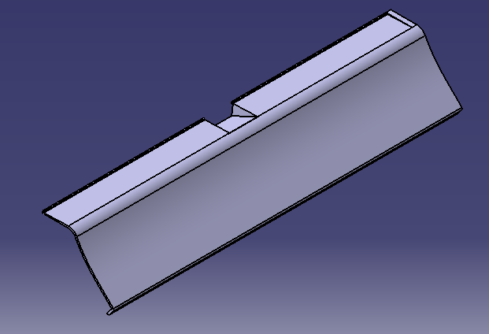
CAD MODEL

Slide 11
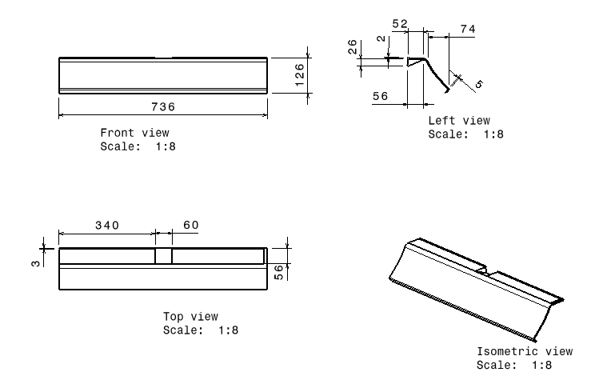

Slide 12

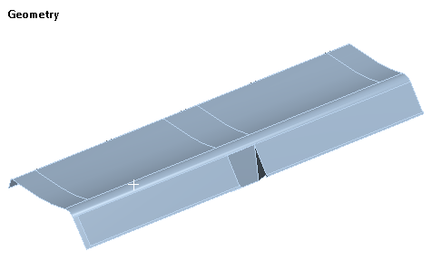
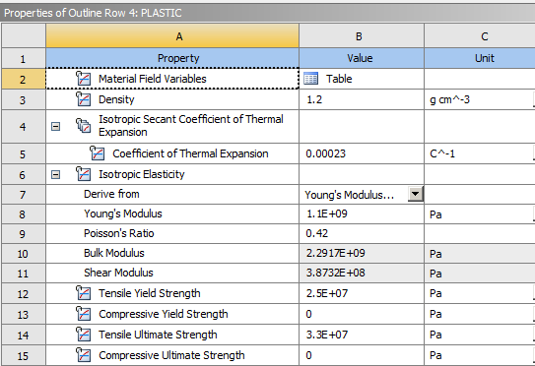
GEOMETRY AND MATERIAL PROPERTIES

Slide 13
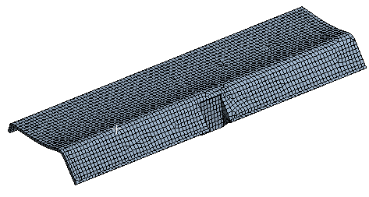
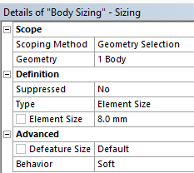


MESHING DETAILS

Slide 14
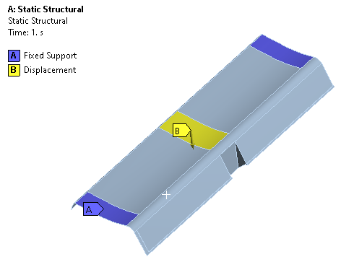
BOUNDARY CONDITION

Slide 15
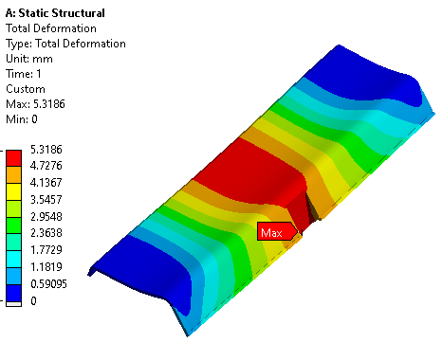
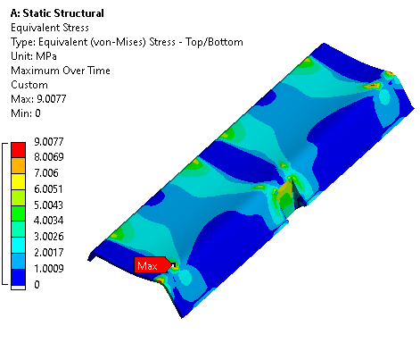
RESULT

Slide 16
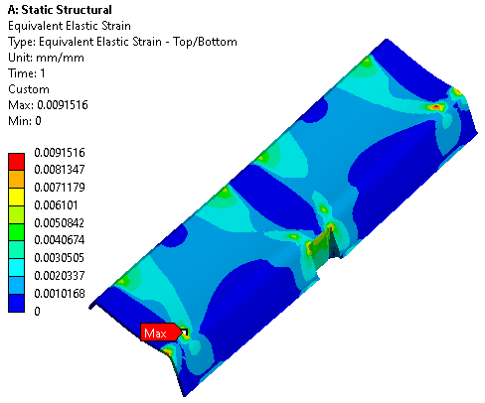
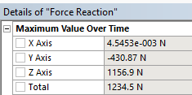
RESULT

Slide 17
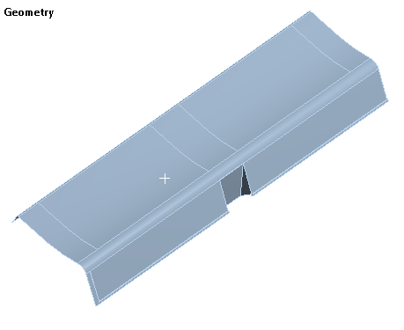
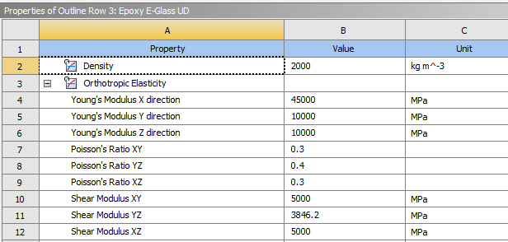
ANALYSIS OF OPTIMIZED ROCKER PANEL USING PLASTIC AND GLASS FIBER COMPOSITE MATERIAL

Slide 18
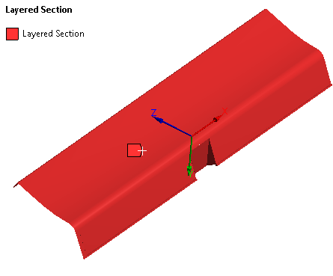
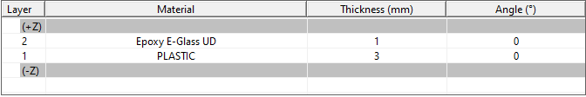

LAYERED SELECTION

Slide 19
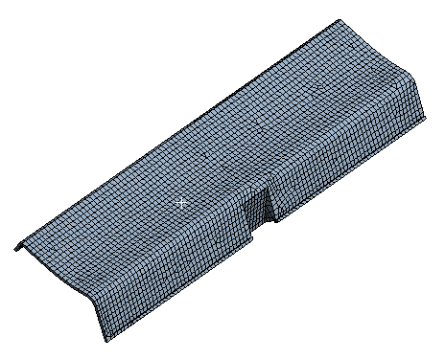
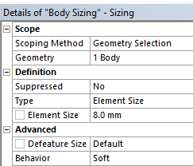

MESHING DETAILS

Slide 20
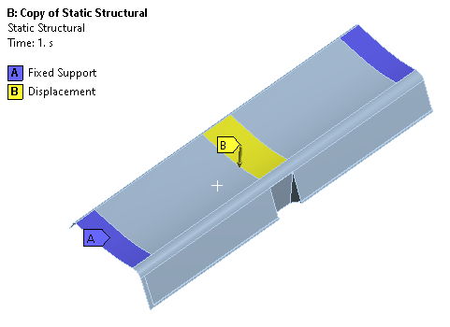
BOUNDARY CONDITION

Slide 21
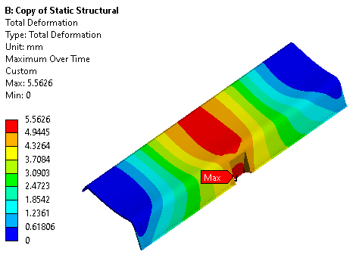
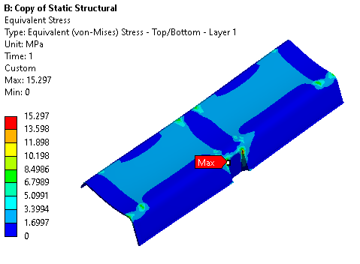
RESULT

Slide 22
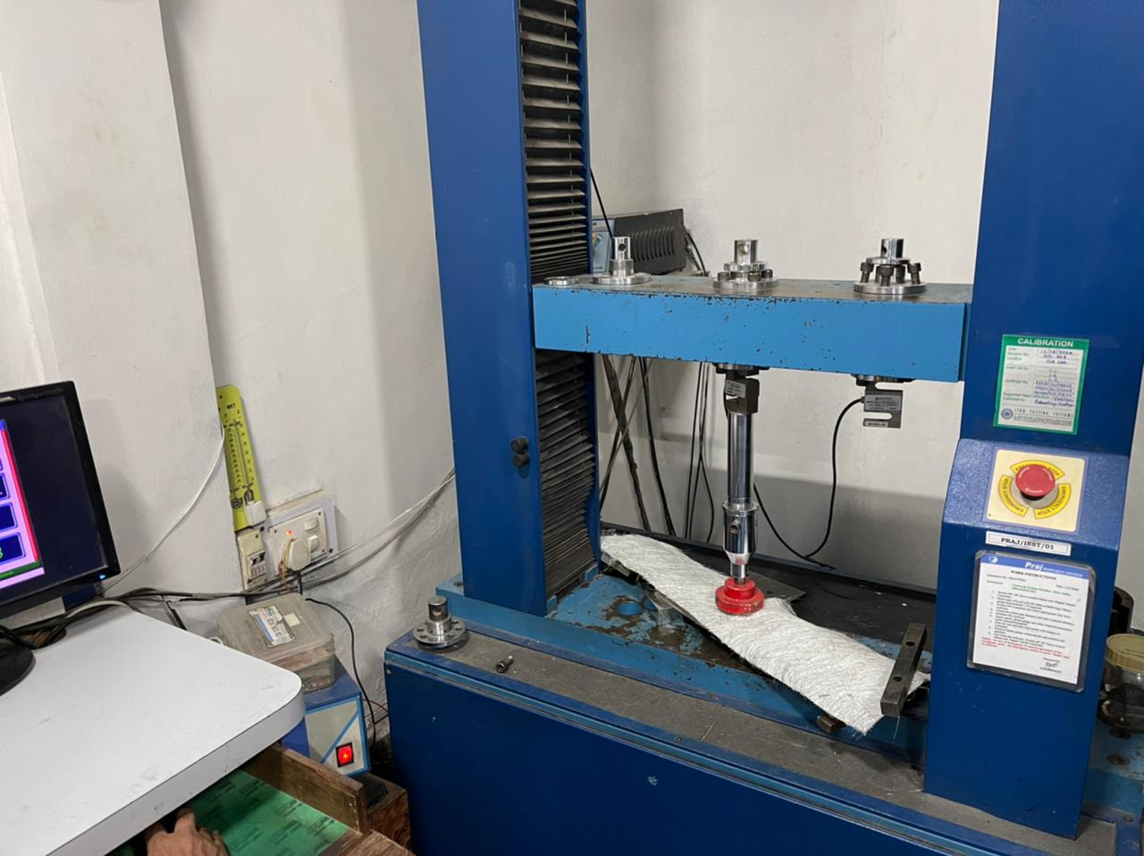
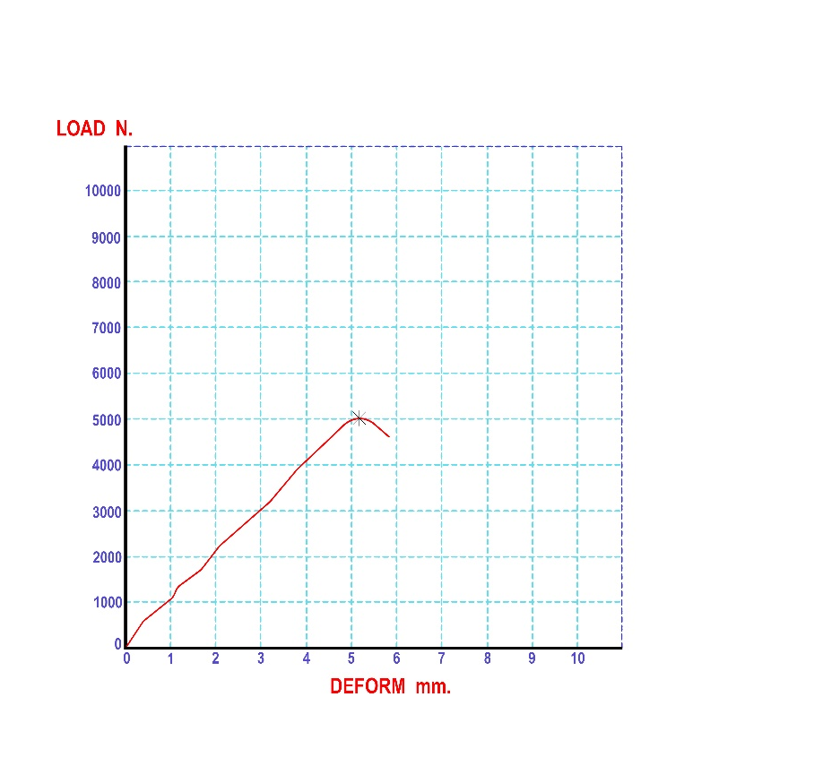
UTM TEST

Slide 23
RESULT
The rocker panel used to protect vehicle from external damage. The material used for rocker panel is plastic. To increase the strength of rocker panel without increasing the glass fiber material is selected.
Applied the glass fiber layer on the rocker panel using hand layup method. As per result the reaction force of rocker panel using composite material is increased.
SR NO | COMPONENT | TOTAL DEFORMATION (mm) | EQUIVALENT STRESS (MPa) | WEIGHT (kg) | REACTION FORCE (N)
1 | EXISTING MODEL | 5.3 | 9.00 | 0.989 | 1234
2 | OPTIMIZED MODEL | 5.5 | 15.29 | 0.92 | 4899

Slide 27

Conclusions
In this project we have performed the structural analysis of Rocker panel made of steel and ploted the result of total deflection and Force reaction of Rocker panel. After the optimization of rocker panel by reducing the thickness of steel plate and layering of carbon fiber the overall weight of the optimized rocker panel is observed.
The optimized rocker panel is also gone through the process of structural analysis and from the plots it is concluded that the optimized rocker panel has best reaction force than the original one. As the reaction force for the original rocker panel is having force reaction of 9754.4 N and the optimized model has the force reaction of 9969.2 N

Slide 28

References
Huili Yu, Hui Zhao and Fangyuan Shi “Bending Performance and Reinforcement of Rocker Panel Components with Unidirectional Carbon Fiber Composite”.
Kumar Hemant, Deb Debasis, Chakravarty D. “Design of crown pillar thickness using finite element method and multivariate regression analysis”.
Corin Reutera,, Kim-Henning Sauerlandb, Thomas Tröstera “Experimental and numerical crushing analysis of circular CFRP tubes under axial impact loading”.
Oleg A. Staroverov, Elena M. Strungar, Valery E. Wildemann “Evaluation of the survivability of CFRP honeycomb-cored panels in compression after impact tests”.
Andrew Miner, Simon Jones “Design, Testing, Analysis, and Material Properties of Carbon Fiber Reinforced Polymers”.
Aleksandr Cherniaev, Clifford Butcher, John Montesano “Predicting the axial crush response of CFRP tubes using three damage-based constitutive models”.

Slide 29

Thank You !
Any

